Slide 1
Online Shopping By Harsh Modi Chandana Sheetanshu Sandeep lanka

Slide 2
Easy Shopping
Easy Shopping is an E-Commerce web application.
Application provides platform for users to buy products and retailers to sell their products through online.
The application UI is very simple and efficient.
This application has 3 users
User
Retailer
Admin

Slide 3
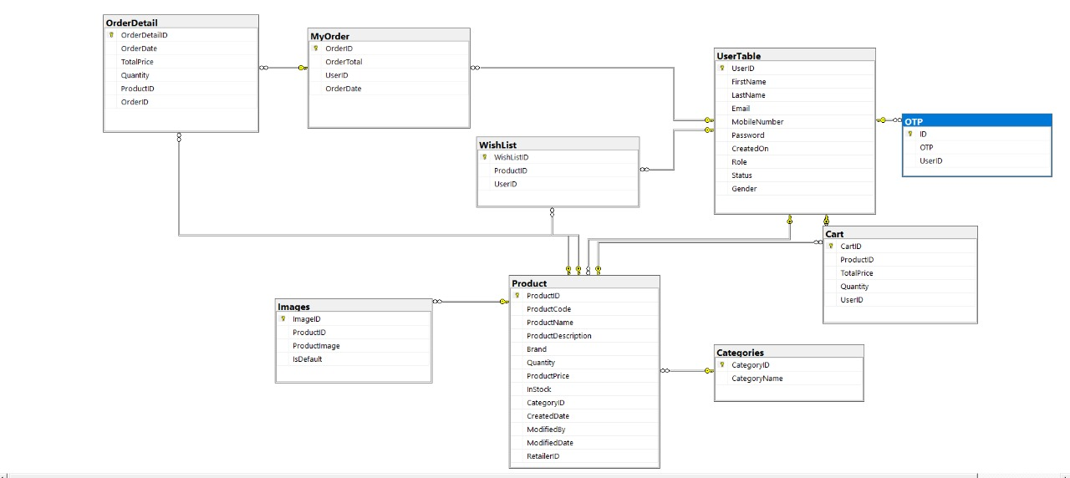
Database Design
Application will implement all the CRUD operations on data base

Slide 4
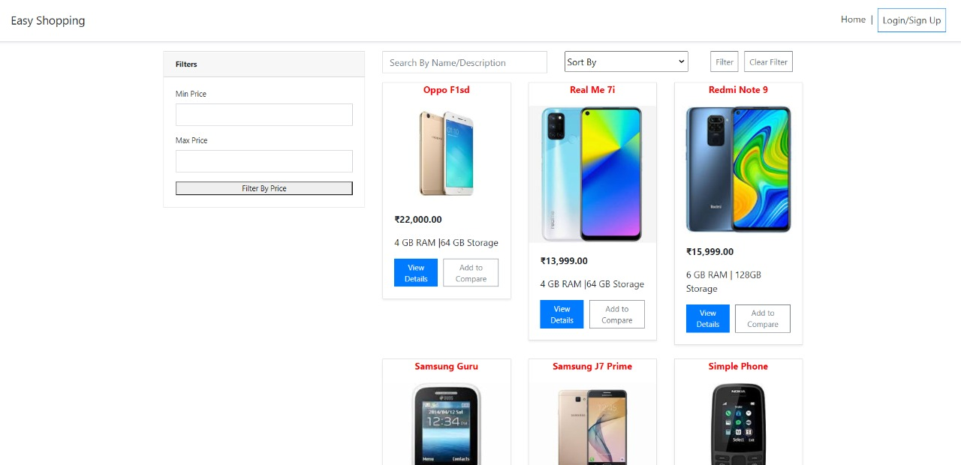
Application View before login

Slide 5
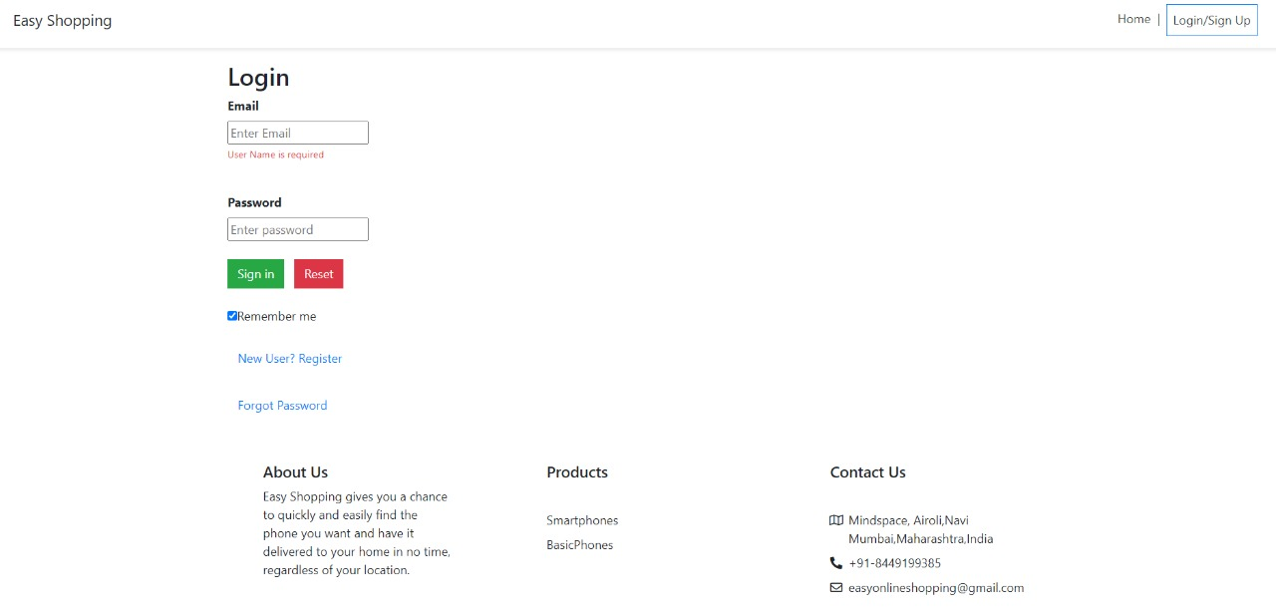
1. User
user login page
New user clicks here for registration
New user clicks here for registration
If registered user forgot password
If registered user forgot password

Slide 6
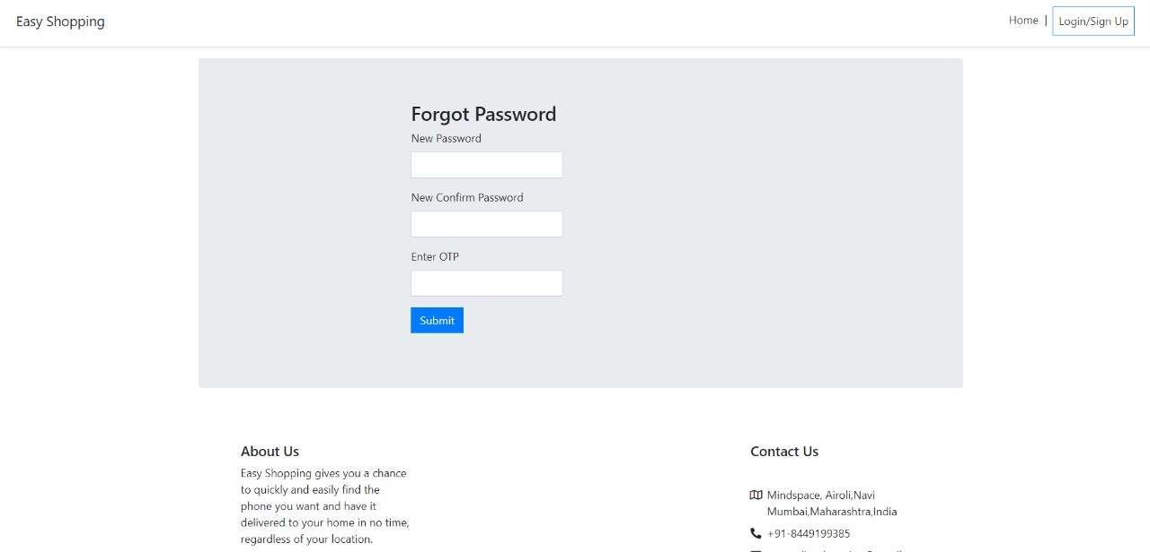
Forgot password page

Slide 7
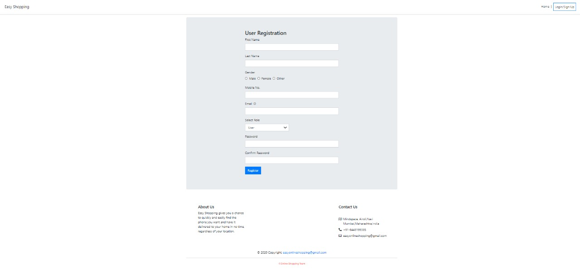
User Registration

Slide 8
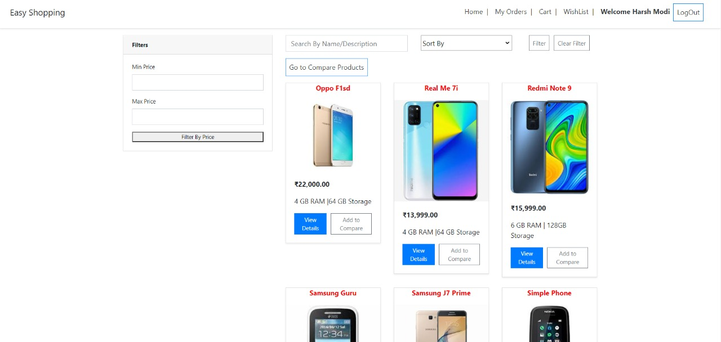
Home page after login

Slide 9
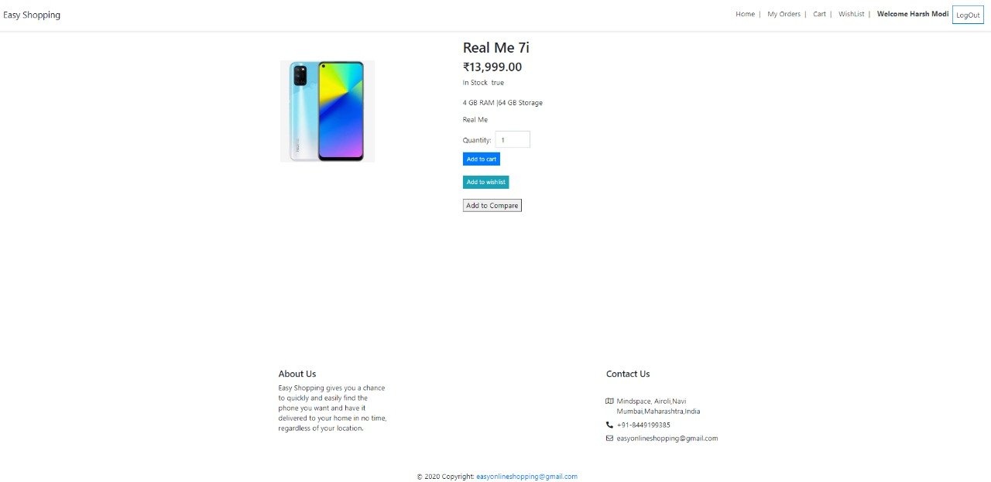
Product description page
Users can add products to cart/wish list here
Users can add this product to compare with other products
Users can add products to cart/wish list here
User can add this product to compare with other products

Slide 10
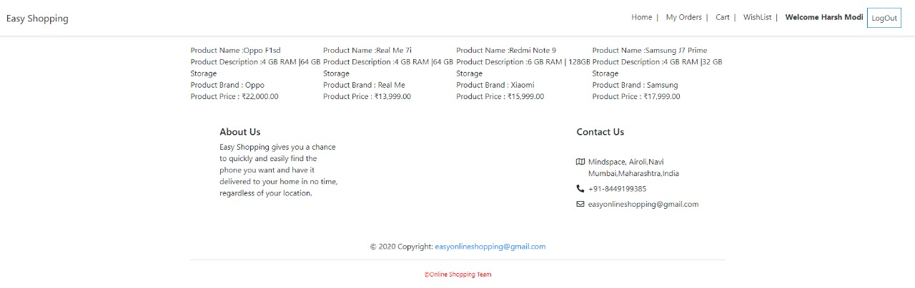
Comparing features of products(up to 4 products)

Slide 11
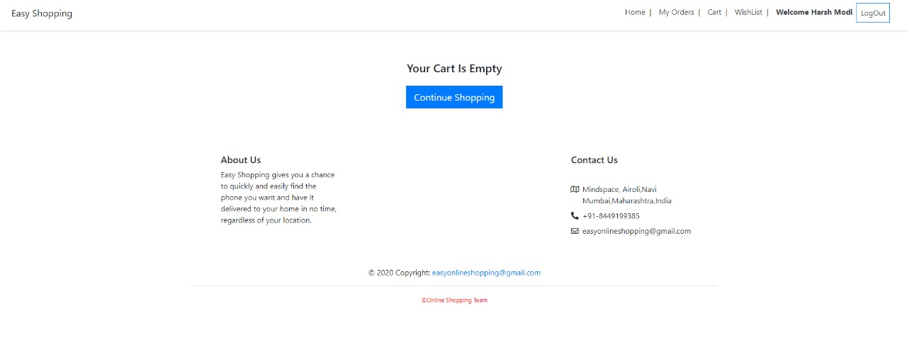
Cart Page
User can change quantity of products here

Slide 12
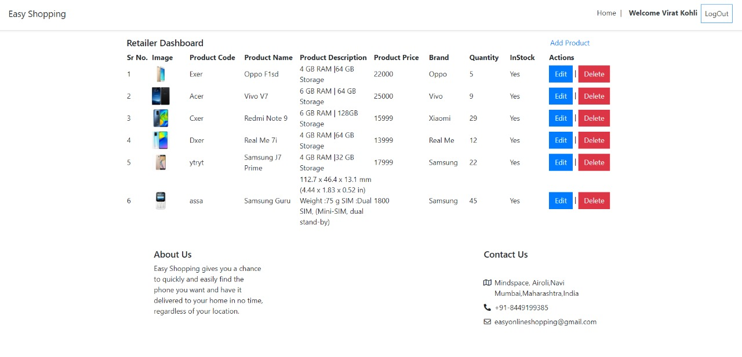
2. Retailer Profile

Slide 13
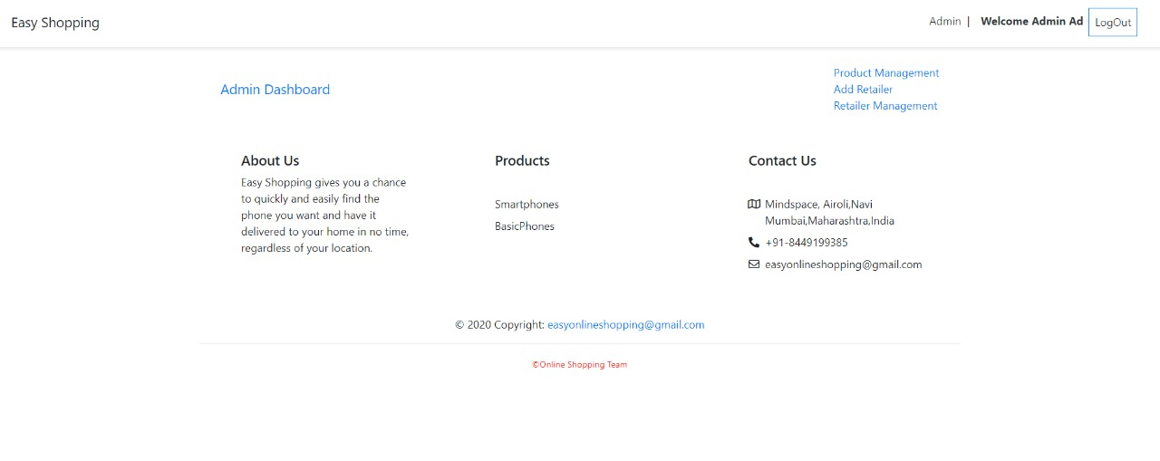
3. Admin Profile

